Slide 1

Autoencoders, Cluster Tracking and Optical Flow for the detection of temporospatial patterns in neural recordings
As part of the project: Information integration in the brain under anaesthesia
Michael Gerstenberger 2020
Notes:
Okay Hello everybody and welcome to my presentation.
Let me start by saying two sentences about myself and my background. So I study cognitive science in Osnabrück and in my master I put a focus on neuroscience as well as computer vision and machine learning. And yeah thats why I joined the project about Information integration in the brain under anaesthesia.
I focus on the methodological aspect and want to find out how autoencoders cluster tracking and optical flow can be used to detect and classify temporospatial patterns in neural recordings.

Slide 2
Outline
Motivation and interest of research
Temporospatial patterns & optical flow
What are temporospatial patterns?
Detecting temporospatial patterns in optical flow
What does dense optical flow measure?
Why optical flow?
Filtering and preprocessing
Details vs. most substantial effect
A custom approach for cluster tracking in the filtered details
Contrast to the expected images
Autoencoders for pattern detection in optical flow
Discussion: A metric for the complexity of brain activity?

Slide 3
Motivation and Interest of Research

Slide 4
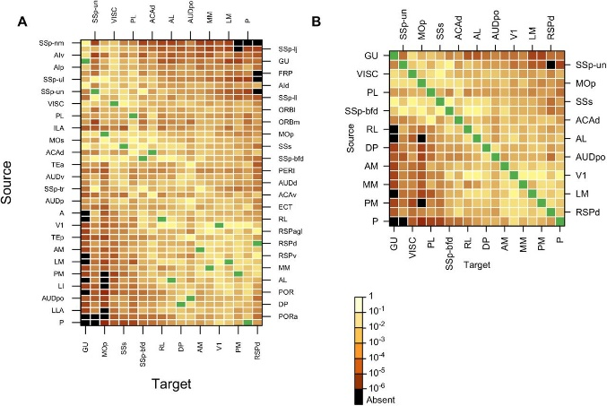
1. Motivation & interest of research
Functional division of brain vs. Highly recurrent nature (regions interact)
→ Spatial patterns of neural information integration?
Correlation strength of neural activity reveals default mode network
→ Temporal dynamic of information integration beyond correlation?
Modes of local information integration? State transitions (e.g. at slow wave sleep; local or temporal)?
To understand how brain regions interact we need to analyze temporospatial patterns
Weighted connectivity matrix (Gămănuţ et al. 2017)
Notes:
So let me start by motivating these questions a little bit.
------------------
Ever since neuroimaging techniques have been used, we found out a lot about the functional division of the brain. We know that there are distinct regions that are necessary to accomplish certain tasks, process features of the perceptual input, direct actions or ensure that memories are formed. From this point of view it looks a lot like the brain is functionally segregated.
However on the other side it is known that the brain is a highly recurrent network. This can be quantified e.g. by electrophysiological recordings or retrograde tracer studies. Here I reported a connectivity matrix for the mouse brain and as you can see it’s a very dense one. Projections especially to far away regions are weaker but exist between almost all of them.
So taken together this throws up the question how information is spatially integrated!
----------------------------------------------------------------
Besides the structural connectivity we can also consider the results of functional connectivity studies. A well known example is the default mode network which relates to a group of brain regions who’s activity correlates at wakeful rest e.g. using fMRI. In other words one investigates the temporal dynamics of information processing.
The fact that a default mode network exists is astonishing, however, by simply computing correlation strength one looses a lot of information about how the information spreads in cortex.
So one can ask how the temporal dynamics can be captures more adequately?
----------------------------------------------------------------
I mentioned that the default mode network relates to wakeful rest, however one may speculate that there are different modes of information integration at different levels of alertness. At slow wave sleep other patterns might occur that potentially relate to processes of memory consolidation. So it’s important to ask: What are the modes of information integration? How can state transitions be investigated in space and time?
These questions are also important because they relate to the big topic of consciousness.
--------------------
To answer these questions we need new means to analyse temporospatial patterns.

Slide 5
1. Motivation & interest of research
How can temporospatial patterns in neuroimaging data be retrieved?
Are there specific patterns that correlate with stages of alertness? What do temporospatial patterns reveal about the dynamics of information processing at different levels of anesthesia?
Notes:
Okay so I think it’s now pretty clear why temporospatial patterns are important.
The big question is now:
- How can they be measured in neuroimaging data?
If there are different modes of information integration one would expect different patterns at different stages of alertness.
→ So we can ask: Are there specific patterns that correlate with stages of alertness? What do temporospatial patterns reveal about the dynamics of information integration at different levels of anesthesia.

Slide 6
Temporospatial patterns & optical flow

Slide 7
2.1 What are temporospatial patterns?
“population-level brain activity is often organized into propagating waves that are structured
in both space and time” (Townsend & Gong 2018)
In an ideal world we would be able to trace how information flows between numerous neurons
→ Temporospatial patterns can be visualized as vector fields
In reality: Even with high speed optical imaging and dense optical flow estimation statements can be
made only for populations of neurons
→ Temporospatial patterns must not be confused with “velocity fields"
Temporospatial patterns indicate a change in the state of the brain over time. They need not be velocity!
Notes:
The term “temporospatial pattern” is a very broad one – which is good – but I think it’s important to clarify what falls under it.
In the context of the term Townsend and gong mention that: “population-level brain activity is often organized into propagating waves that are structured in both space and time” (Townsend & Gong 2018).
In an ideal world we would be able to trace how information flows between numerous neurons and visualize that in the form of vector fields.
In reality, even with high speed optical imaging and dense optical flow estimation statements can be made only for populations of neurons

Slide 8
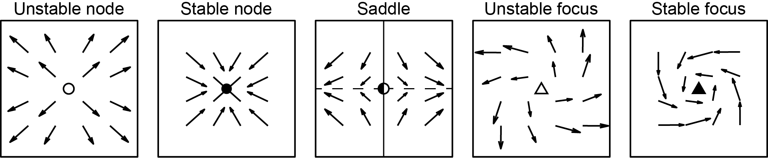
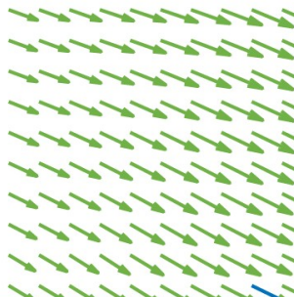
2.2 Temporospatial patterns in optical flow
Tunsend and Gong (2017) suggest measuring specific patterns in dense optical flow
Focal patterns
Global patterns
Plane wave
Synchrony
vector length of phase
(band pass filtered)
The suggested definiton allows for the detection of patterns irrespective of their orientation
Patterns in vector fields can be arbitrarily defiend and their occurence measured accordingly

Slide 9
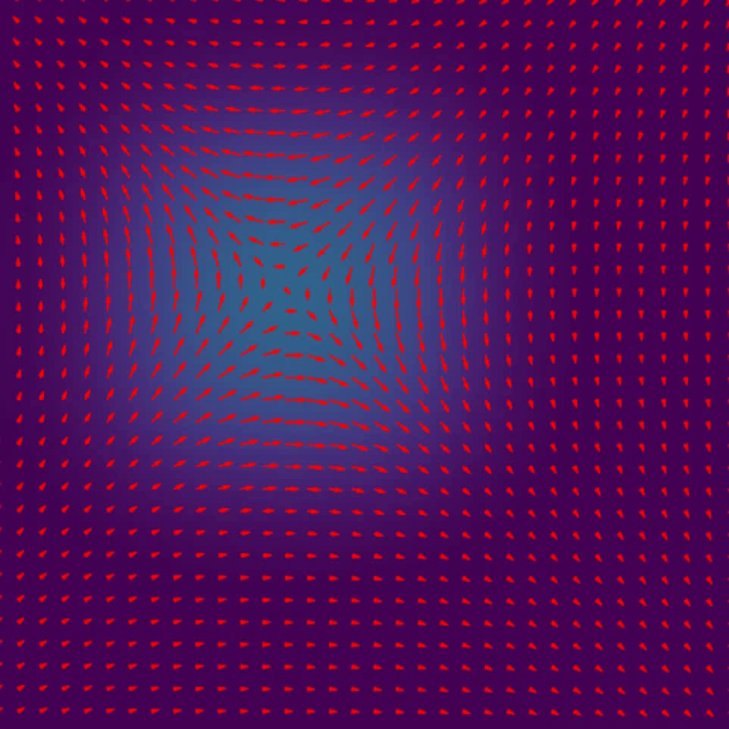
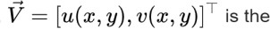
2.3 What does dense optical flow measure?
Minimize Energy functional
Horn & Schunck’s method is based on the gradient in time (and space)
Focal patterns like saddles arguably relate to a rising peak
Spirals might relate to activity that increases at some part of the neighbourhood and decreases at others.
Patterns in dense optical flow do not necessarily capture motion
Focal patterns do arguably not relate to velocities of travelling signals
Notes:
Spirals might relate to activity that increases at some part of the neighbourhood and decreases at others.
How does optical flow relate to gradient for data with no motion but growing peaks?

Slide 10
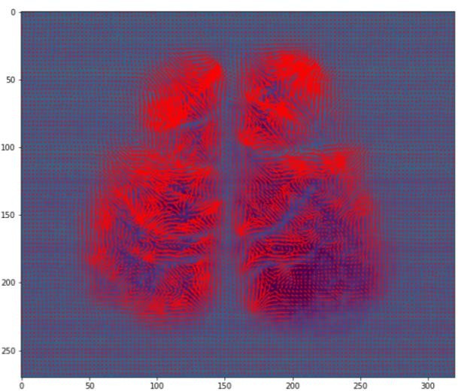
2.3 What does dense optical flow measure?
Minimize Energy functional
Horn & Schunck’s method is based on the gradient in time (and space)
Focal patterns like saddles arguably relate to a rising peak
Spirals might relate to activity that increases at some part of the neighbourhood and decreases at others.
Patterns in dense optical flow do not necessarily capture motion
Focal patterns do arguably not relate to velocities of travelling signals
Notes:
Spirals might relate to activity that increases at some part of the neighbourhood and decreases at others.
How does optical flow relate to gradient for data with no motion but growing peaks?

Slide 11
2.4 Why optical flow?
Optical flow fields indicate temporal dynamics of the brain in a single vector field
(e.g. decrease in V1 increase in V2 stable at M1)
→ Vector fields are a good tool for visualization of temporospatial dynamics of neural activity
If there is a transition of peak activation optical flow may indicates the direction of travelling waves
Optical flow indicates the temporospatial dynamic of neural signals and can easily be visualized

Slide 12
Filtering and preprocessing

Slide 13
3. Filtering and preprocessing
How to quantify temporospatial dynamics? Where to look?
feature engineering
 |  | Raw data (/little preprocessing) | Focus: Most substantial effect |  | Focus: Details
 |  |  | Optical flow | Contrast enhanced | Optical flow | Cluster tracking | Contrast enhanced
Detect predefined patterns |  | x | ✓ | ? | ✓ | ? | (✓)
Data driven: Autoencoder | Regional | ✓ | ✓ | ✓ | ✓ | ✓ | ✓
 | Global | ✓ | ✓ | ✓ | ✓ | ✓ | ✓
data
classification
Data driven approaches are more flexible. There are many options.

Slide 14
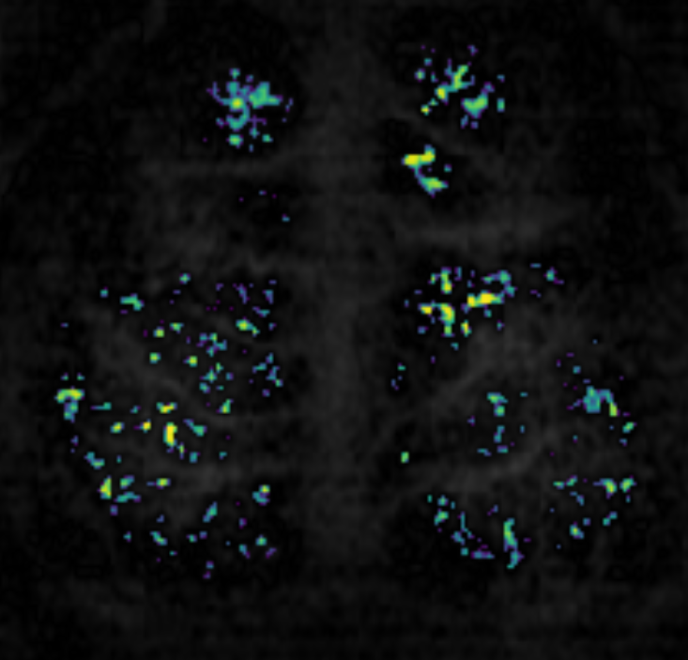
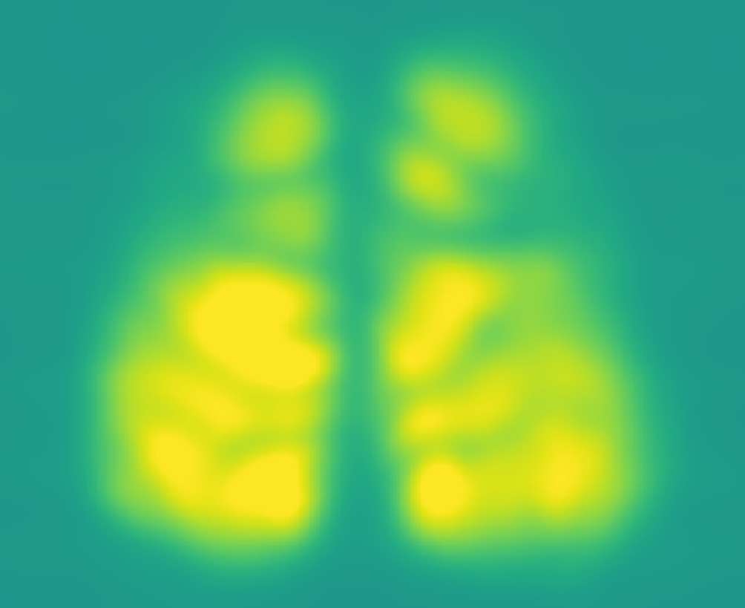
3.1 Details vs. Most substantial effect
Focus on details
Remove details
(+) complex temporospatial pattern (local)
(-) strong contribution of bloodflow
(+) robust neural signal
(-) complexity only on whole brain scope
(-) Effect of anatomical structures

Slide 15
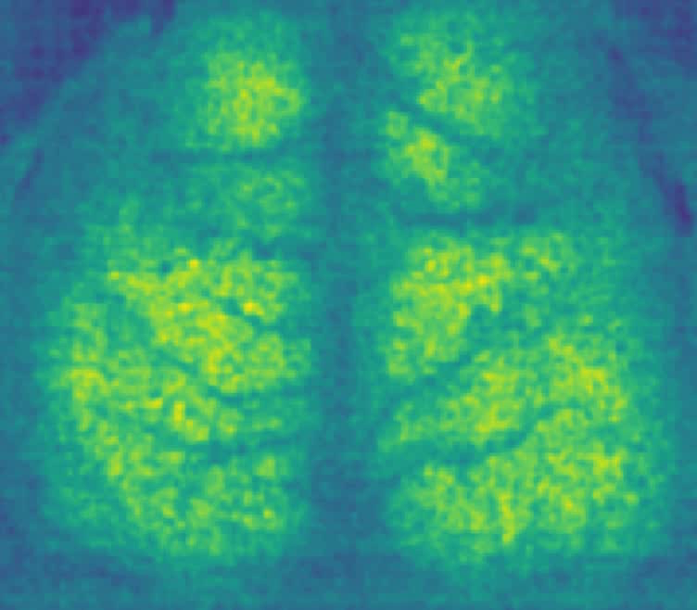
3.2 Cluster tracking for details in microscopic patterns
raw data
v
select region of interest
Preprocessing stage 1
v
v
pixelwise mean
difference & smoothing
v
difference to pixelwise mean
v
framewise normalization
Is it all due to bloodflow? How find out?

Slide 16
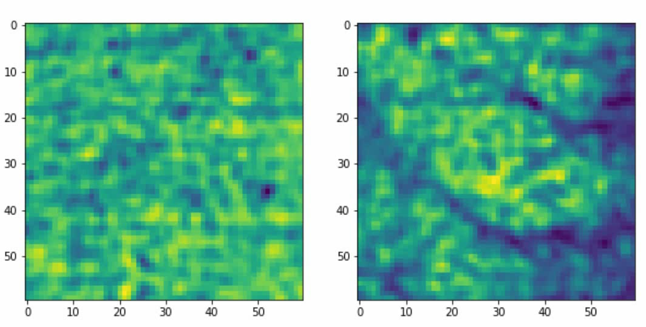
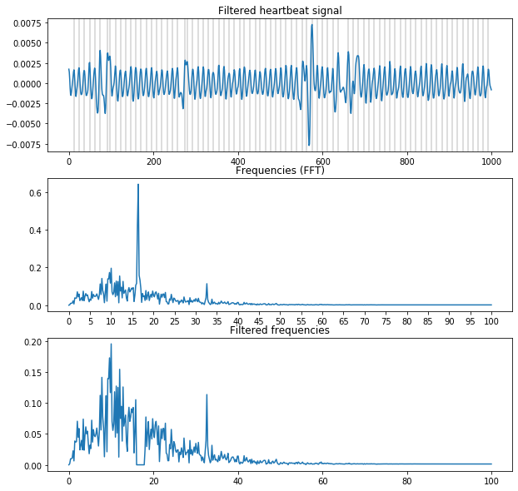
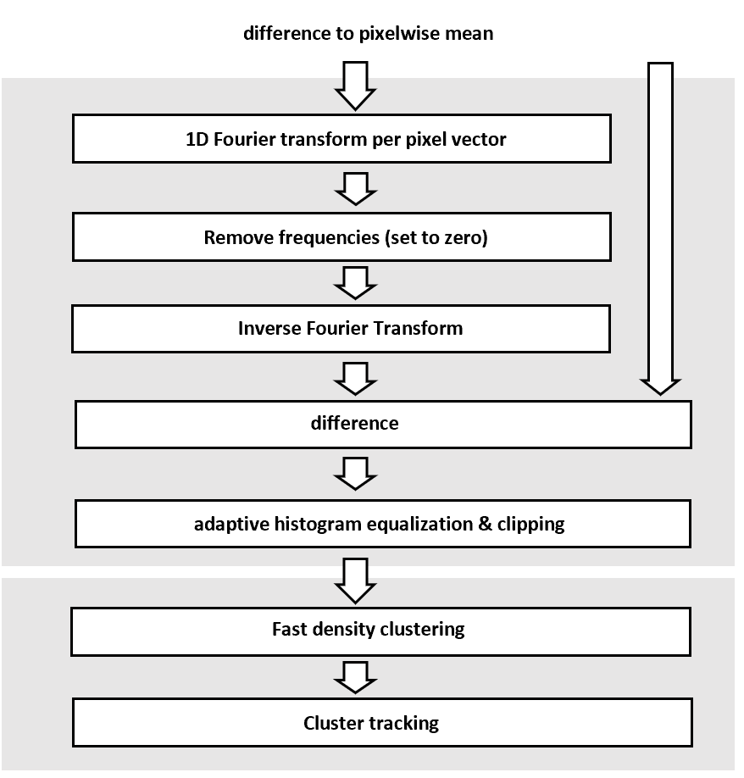
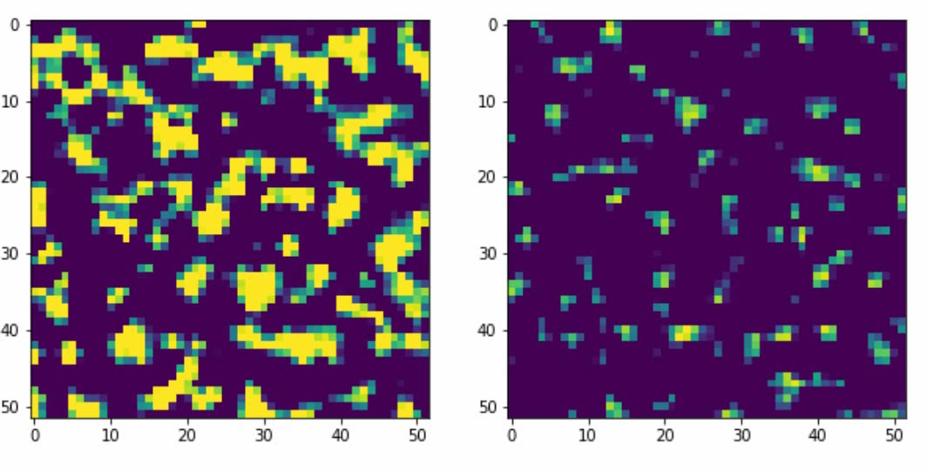
3.2 Cluster tracking for details in microscopic patterns
Is it all due to bloodflow? How find out?
Details vs. Bloodflow (~16Hz)

Slide 17
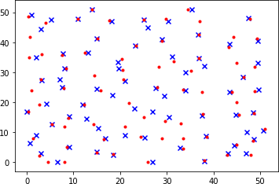
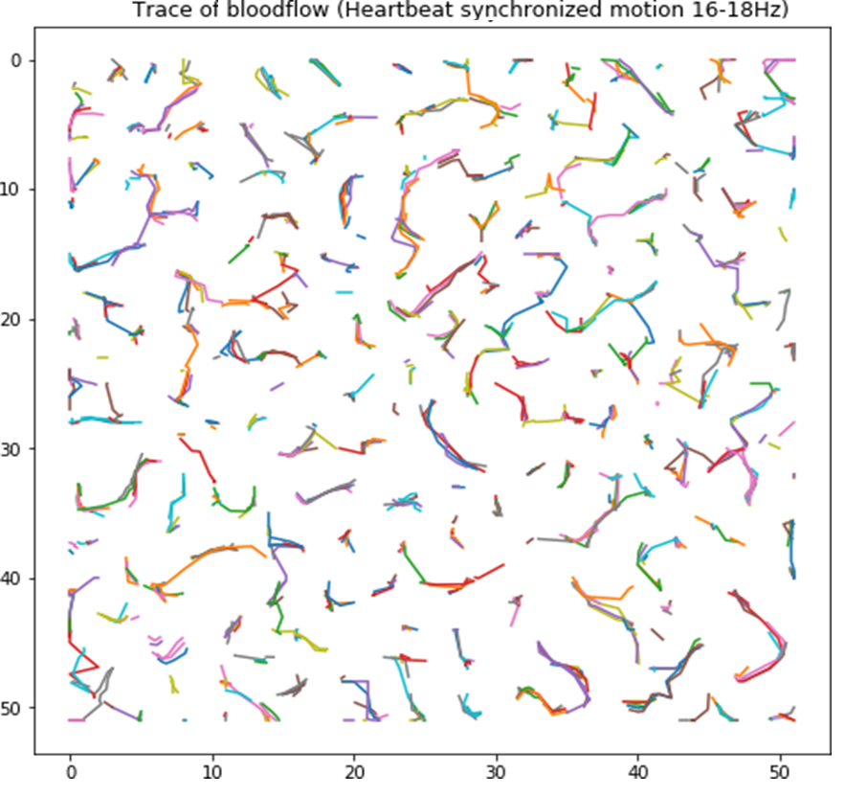
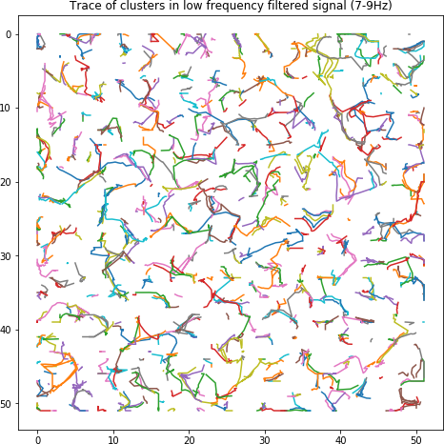
3.2 Cluster tracking for details in microscopic patterns
A custom approach allows for clustering and tracking
Clustering is achieved using a mean shift technique in a density-based approach
Tracking is based on the location of the cluster centres
Cluster tracking can be used to identify temporospatial patterns in neuroimaging data that relate to bloodflow
One may retrieve trajectories for vessels of different size

Slide 18
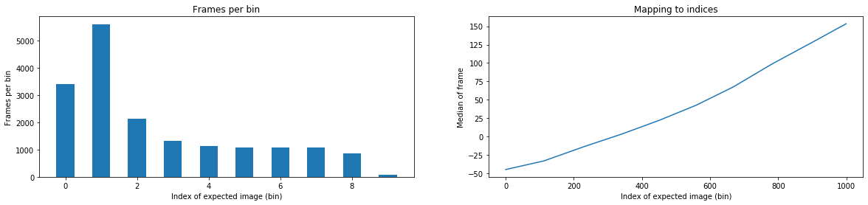
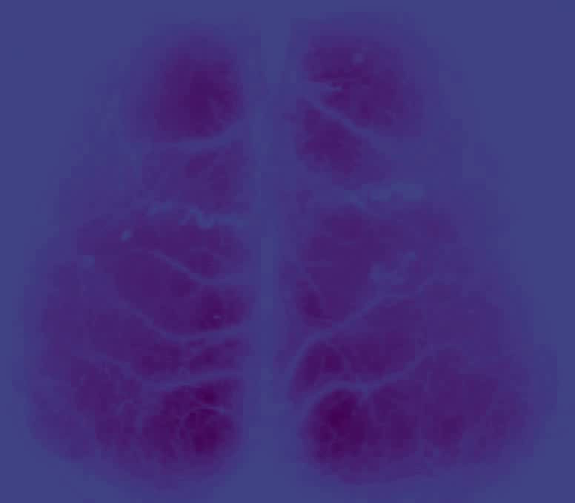
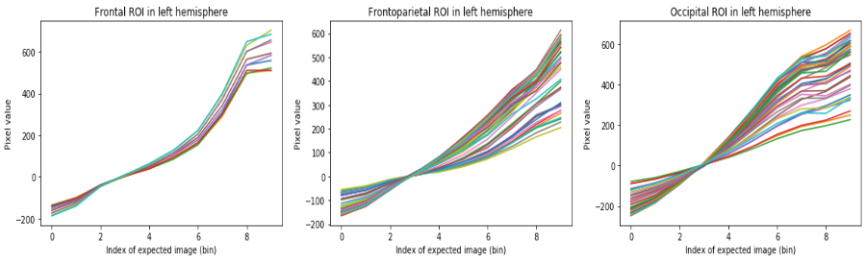
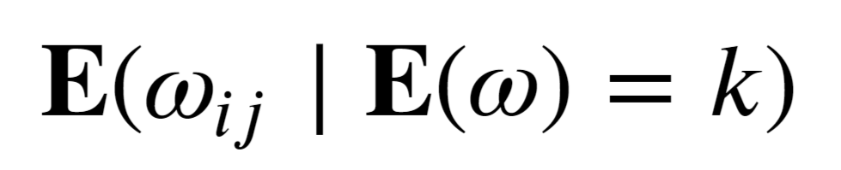
3.3 Contrast to expected frames
Temporospatial patterns do not necessarily relate to the overall magnitude (ANN should not learn similarity based on mean)
→ The contrast to the expected image given the mean(/median) overall brightness is computed
Interpretation: → Contrast shows how individual slow waves are different from the mean slow wave
→ The impact of anatomical structures is reduced
→ If the raw data is similar so is the difference to the expected value

Slide 19
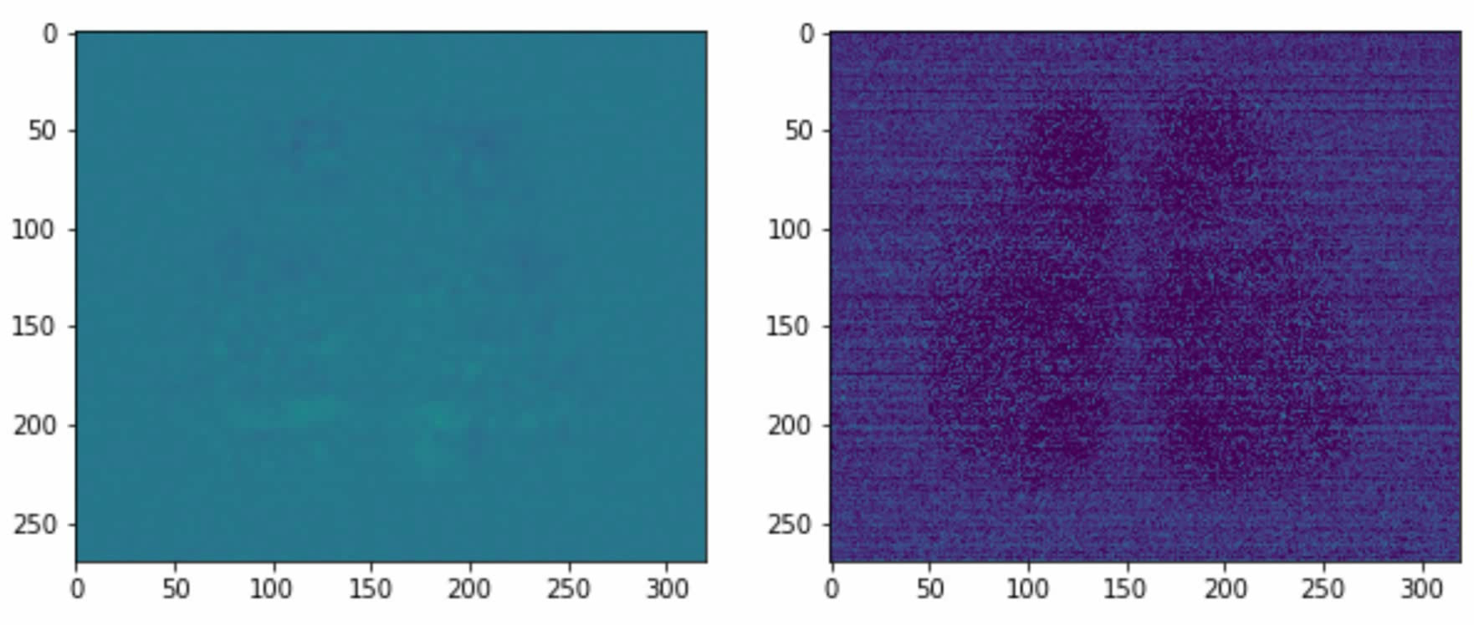
3.3 Contrast to expected frames
Interpretation: → Contrast shows how individual slow waves are different from the mean slow wave
→ The impact of anatomical structures is reduced
→ If the raw data is similar so is the difference to the expected value

Slide 20
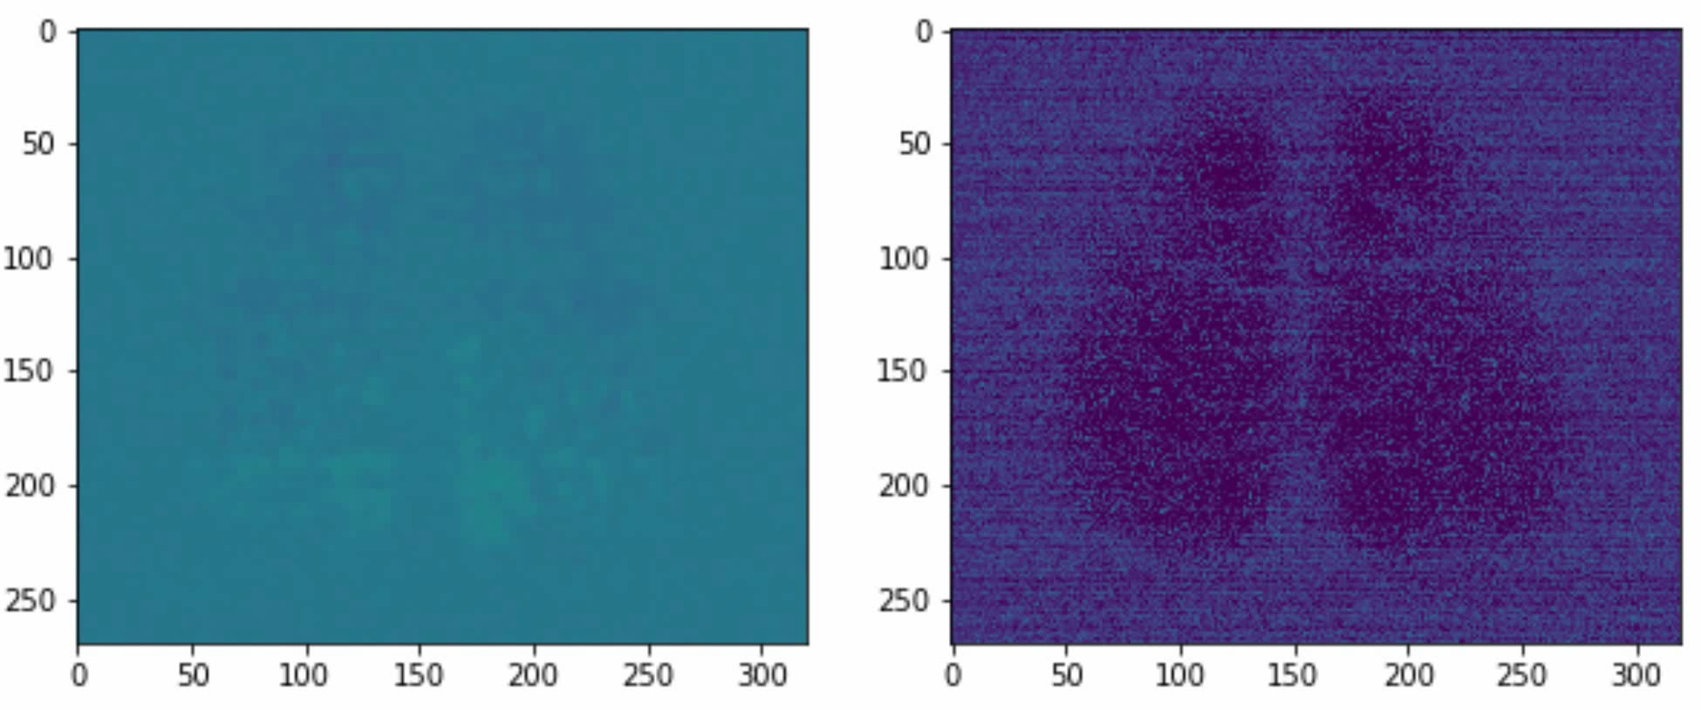
3.3 Contrast to expected frames
Interpretation: → Contrast shows how individual slow waves are different from the mean slow wave
→ The impact of anatomical structures is reduced
→ If the raw data is similar so is the difference to the expected value

Slide 21
Autoencoders for pattern detection in optical flow

Slide 22
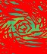
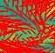
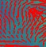
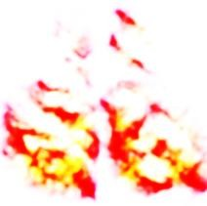
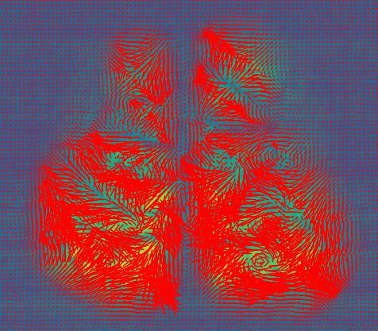
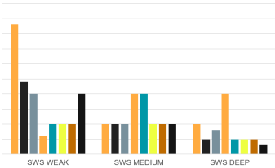
4.1 Autoencoders and regional scale temporospatial patterns
A
B C
…
1
2
n
Latent layer state 1 … n
D
???
…
1
2
n
Fig 1: Scheme for the detection and classification of temporospatial patterns using autoencoders
A: Sampling of patches in the optical flow (/motion fields)
B: Using a convolutional variational autoencoder for unsupervised pattern classification
C: Density heatmaps for different patterns
D: Probability of the presence of different patterns during different stages of alertness (slow wave)

Slide 23
4.1 Regional scale: Classification and detection of temporospatial patterns with autoencoders
Raw data
Identify local scale temporospatial patterns
Average in space or per condition
Challenges:
Artifacts due to anatomical structures (?)
Avoid introduce a bias with respect to the conditions because of artifacts

Slide 24
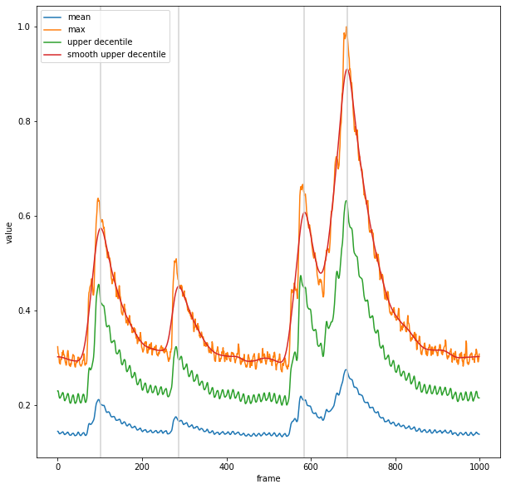
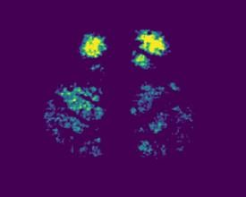
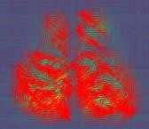
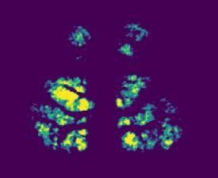

4.2 Autoencoders: Global scale temporospatial patterns
A
???
B
...
???
C
Latent space
brain state transitions
???
???
Fig 1: Autoencoders as a tool for the analysis of dynamical state transitions in latent brain state space A: Temporal dynamics of slow wave event
B: Spatial dynamics of slow wave event
C: Whole brain autoencoder reveals latent space of brain state transitions

Slide 25
4.3 Global scale temporospatial patterns & local scale patterns
Raw data
Identify similar dynamical brain states
( = global temporospatial patterns)
(…)
Average over similar states to improve signal to noise ratio
Identify local scale temporospatial patterns
Advantages:
The contrast to the expected image can be used to identify similar dynamics (and not magnitude)
Averaging over data for similar states increases the signal to noise ratio
→ One may hope to see travelling signals directly
→ One can confirm visually that retrieved vector fields capture the dynamics (sanity check)
Notes:
(remove effect of anatomical structures)

Slide 26
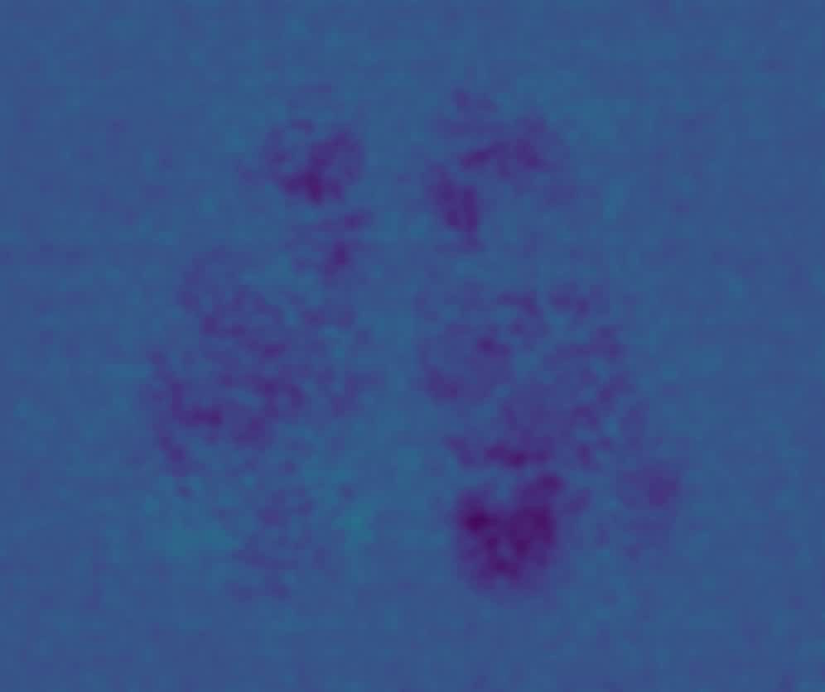
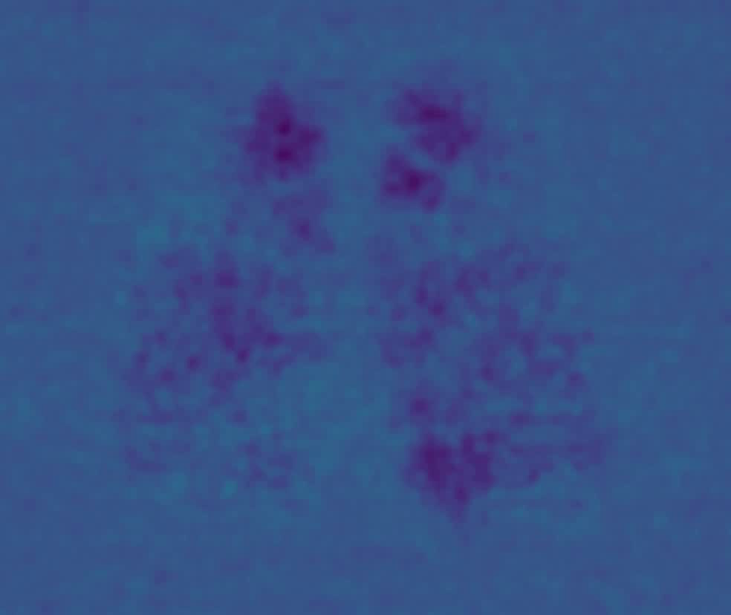
4.3 Global scale temporospatial patterns & local scale patterns
Two examples for global scale temporospatial patterns (contrast to expected image)

Slide 27
Discussion:
A metric for the complexity of brain activity based on temporospatial patterns?

Slide 28
5. A metric for the complexity of brain activity?
The Perturbational Complexity Index is computed by compressing the (EEG) response to (TMS) stimulation
Autoencoders can be considered a compression technique. One can get a sparse representation of
the signal using an autoencoder trained on the vector fields. The latent layer activation can e.g. be discretized and compressed using RLE. The entropy of the sparse representation can be computed.
If one finds a higher compression ratio (/less entropy in the sparse representation) for deeper levels of anaesthesia one may argue that it‘s justified to assume a less complex brain state
One may apply a complexity metric on the sparse representation retrieved by autoencoders

Slide 29
8. Literature
Gămănuţ, R., Kennedy, H., Toroczkai, Z., Van Essen, D., Knoblauch, K., & Burkhalter, A. (2017). The mouse cortical interareal network reveals well defined connectivity profiles and an ultra dense cortical graph. bioRxiv, 156976.

Slide 30
7. A metric for the complexity of brain activity?
Limitation: Autoencoders are lossy compression
The value of the metric depends on the design of the autoencoder. Fewer latent layer neurons mean less accurate reconstructions but a higher compression ratio.
→ One may compare between conditions, but one may not retrieve an absolute value for the complexity.
Challenge: Bias in data or due to training?
If some categories are underrepresented in the data (maybe important temporospatial patterns) the ANN is likely not to encode them.
Is the magnitude of pixel values or the spatial structure of the input important?
Autoencoders optimize the reconstruction loss which is large when there is a large absolute mismatch (SSE).
Slow wave anaesthesia is be very different up state anaesthesia.
How about other conditions?
In slow wave anaesthesia there are patterns in the most substantial effect (details removed)
This is due to the transition between up-states and down states

Slide 31
Notes on open questions / possibilities

Slide 32
...
Ehance data (flip & rotate) aiming at detection of rotation invariant patterns?
If one wants to detect rotation invariant features? How do that with autoencoders?

Slide 33
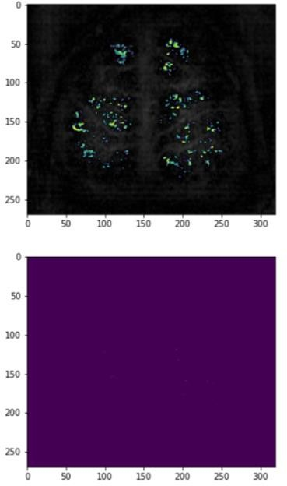
Preprocessing & vector field computation
Removing details results in more robust yet rather less complex measures
How many details should be removed
(e.g. do anatomical features have an effect on the optical flow)?
One can try removing vascular blood flow by removing PCA components that correlate with the heartbeat or removing the respective frequencies in from the pixel-vectors using FFT.
Open question: What is the best way to go here?
Filtering details results in complex patterns.
(+) If it is possible to remove undesired effects one would be able to correlate the overall level of activity (alertness) with patterns of information processing e.g. during up and down-states of slow wave sleep (!!!).
(-) However details are strongly confounded by vascular blood flow (blood only?)

Slide 34
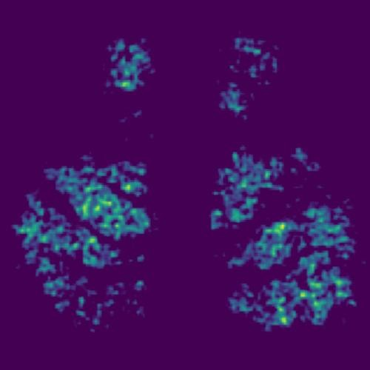
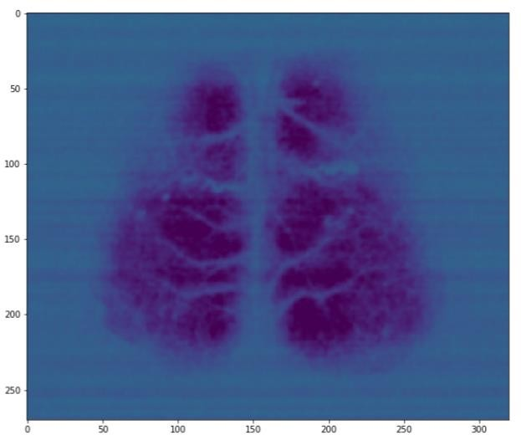
6.2 Optical flow for macroscopic patterns
Upper decentiles
First PCAs and Horn Schunck
Open questions:
Is Horn Schunck sensitive to anatomical structures? How to deal with that?
Are patterns visible for the other conditions also or only when slow waves occur?

Slide 35
...
Sampling windows at different locations or using the whole brain recordings?
→ Training on patches; using pretrained autoencoder for whole brain encoeder!
Training of autoencoder tied to spacial region
Whole brain recordings & Variational autoencoder:
(+) Possibility to track transitions between brain states in 2D latent space
Investigate for which brain states a second peak occurs
Region of interest based analysis
(+) Impact of vessels on optical flow is less important
Training of autoencoder for random samples of motion vectors
(-) Impact of vessels on the shape of the optical flow (If one finds differences between conditions it’s hard to understand what they relate to)
(+)Possibility to perform pattern detection and retrieve heat-maps for different patterns. Then correlate with level of anesthesia
(It’s clear that there will be more saddles for slow wave sleep because of the growing peaks).
Using single or multiple scale input?

Slide 36
difference to pixelwise mean
v
v
raw data
1D Fourier transform per pixel vector
v
select region of interest
v
Remove frequencies (set to zero)
v
v
Preprocessing stage 1
pixelwise mean
v
Inverse Fourier Transform
v
difference & smoothing
difference
v
v
difference to pixelwise mean
adaptive histogram equalization & clipping
v
Fast density clustering
v
Cluster tracking

